Slide 1
Technical Arts (TA 101AA)
Engineering Graphics
Prof. Nachiketa Tiwari
Department of Design

Slide 2
Planes

Slide 3
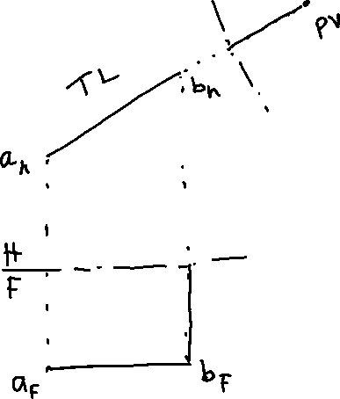

Planes
A large number of points make up a line.
True length of a line.
Point view of a line.
A large number of lines make up a plane.

Slide 4
Projection of Planes
A plane can be defined by one of the following.
  Three points
  One point and one line
  Two lines: These could be parallel, or intersecting.
Planes are infinite in size.
Thus, defining a plane simply implies defining its orientation, and location in 3-D space.
Orientation of plane in space: “Strike” and “Dip”.

Slide 5
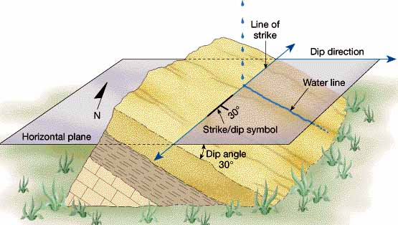
Strike and Dip

Slide 6
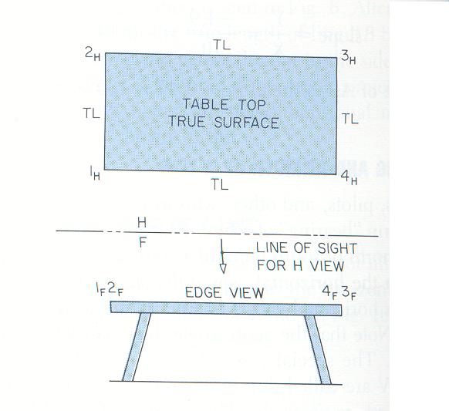

Edge View of a Plane/Normal View of a Plane
A large number of points make up a line.
A large number of lines make up a plane.
True length of a line.
Point view of a line.
Edge view of a plane.

Slide 7
Auxiliary View of an Oblique Line
H
H or A2
A_{H}
B_{H}
A
A_{F}
F or A1
B
F
A_{A}
True Length/Normal View)
B_{F}
P
A
B_{A}
A3
LINE OF SIGHT
A3: Plane on which auxiliary view is projected
A2: Plane from which projectors emanate
A1: Plane from which measurements are taken
Note: Following plane-pairs are orthogonal: A1-A2; A2-A3

Slide 8
Classification of Planes
Based on the number of principal planes on which the plane appears in its edge view.
Case 1: The plane in appears in its edge view in two principal planes of projection, and is parallel to the third plane. Thus it appears Normal in its third view.
  The plane is after its normal view (3 possibilities).
Case 2: A plane appears in its edge view on one principal plane, and is inclined to the two other principal planes. (3 possibilities).
Case 3: A plane inclined to all the three principal planes. Such a plane is termed Oblique Plane.
  Infinite possibilities.

Slide 9

Classification of Planes
B_{H}
N
A_{H}
C_{H}
H
F
A_{F}
B_{F}
C_{F}
C_{P}
A_{P}
B_{P}
P
HORIZONTAL PLANE

Slide 10
Classification of Planes
A_{H}
B_{H}
C_{H}
H
F
B_{F}
B_{P}
N
C_{P}
C_{F}
A_{P}
A_{F}
P
FRONTAL PLANE

Slide 11
Classification of Planes
A_{H}
C_{H}
B_{H}
H
F
P
C_{F}
C_{P}
B_{P}
N
B_{F}
A_{F}
A_{P}
PROFILE PLANE

Slide 12
Classification of Planes
B_{H}
N
Indicates the direction of normal on plane or the direction from where plane can be seen as Normal
A_{H}
C_{H}
H
F
A_{P}
A_{F}
N
Draw the projection of such plane in H and P.
B_{F}
B_{P}
Edge View (EV)
C_{F}
C_{P}
Inclined to Horizontal and Profile
Perpendicular to Frontal
P

Slide 13
Classification of Planes
C_{H}
Edge View (EV)
B_{H}
N
A_{H}
H
F
B_{F}
B_{P}
A_{F}
A_{P}
C_{P}
C_{F}
Inclined to Frontal and Profile
Perpendicular to Horizontal
P

Slide 14
Classification of Planes
C_{H}
B_{H}
A_{H}
H
F
A_{P}
A_{F}
N
B_{P}
B_{F}
Edge View (EV)
C_{F}
C_{P}
Inclined to Frontal and Horizontal
Perpendicular to Profile
P

Slide 15
Classification of Planes
C_{H}
B_{H}
A_{H}
H
F
A_{F}
A_{P}
B_{F}
B_{P}
C_{P}
C_{F}
Oblique Plane
Inclined to All Principal Planes
P

Slide 16
Finding Normal View
of Oblique Planes

Slide 17
Goal: Given an Oblique Plane, Developing its Auxiliary Plane Which is Normal
B_{H}
Problem Statement
We know two projections of plane ABC.
How do we find its normal view?
A_{H}
C_{H}
H
F
B_{F}
A_{F}
C_{F}

Slide 18
Goal: Given an Oblique Plane, Developing its Auxiliary Plane Which is Normal
B_{H}
Overall Process
First develop Edge View (EV) of plane ABC.
Next, using the edge view, develop a plane orthogonal to it.
Getting EV of Plane ABC & Its Normal View
Identify a point D_{F} on line B_{F}-C_{F} such that A_{F}-D_{F} is of TL.
If A_{F}-D_{F} is of TL, then the plane ABC when viewed in the direction of EV of A_{F}-D_{F}, will appear as a straight line. Such a view will be the EV of plane ABC.
The edge view of ABC can be used to develop normal view of plane ABC.
A_{H}
D_{H}
C_{H}
H
F
B_{F}
D_{F}
TL
A_{F}
C_{F}

Slide 19
Goal: Given an Oblique Plane, Developing its Auxiliary Plane Which is Normal
B_{H}
Identifying Point D_{F} Such that A_{F}-D_{F} is of TL.
Identify D_{H} on H-Plane such that A_{H}-D_{H} is parallel to H-F hinge line.
In such a case, the hinge line H-F becomes also a hinge line for an auxiliary plane across which, if A_{H}-D_{H} is projected, we will get its TL.
Thus, A_{F}-D_{F} is normal view of line A-D, and its length is the TL.
A_{H}
D_{H}
C_{H}
H
F
B_{F}
D_{F}
TL
A_{F}
C_{F}

Slide 20
Normal View of an Oblique Plane
B_{H}
A1
A2
B_{A1}
B_{A2}
A_{H}
D_{H}
EV
C_{H}
D_{A1,}A_{A1}
D_{A2}
N
H
A_{A2}
B_{F}
TS
F
C_{A1}
C_{A2}
D_{F}
TL
A_{F}
C_{F}
F
A1
TL: True Length
TS: True Shape

Slide 21














$$C_{A1}$$
The Same Method When TL of Line AD is Generated in H Plane
$$C_{A2}$$
PV
$$C_{H}$$
$$A_{A2}$$
EV
TS
$$D_{H}$$
TL
$$A_{H}$$
$$B_{A1}$$
$$B_{A2}$$
$$B_{H}$$
H
A1
A1
A2
H
F
$$B_{F}$$
$$D_{F}$$
$$A_{F}$$
$$C_{F}$$

Slide 22
TS of Plane by Rotation Method
B_{H}
B/_{A1}
B_{A1}
A_{H}
D_{H}
C_{H}
D_{A1,}A_{A1}
H
B/_{F}
C_{A1}
F
C/_{A1}
B_{F}
D_{F}
A1
F
TL
C_{F}
A_{F}
C/_{F}
Notes:
If we see an oblique plane in its edge view we can then rotate it so we make the plane parallel to one of the views. This is being done here. The plane has been make parallel to the frontal plane.
As seen in rotation of line—one point D is fixed and we are rotating the line DB so the B in frontal will oscillate along the line DB. Similarly C will oscillate along DC. The rotation is given by keeping D fixed and B and C being rotated.

Slide 23
Line-Plane Relationships

Slide 24
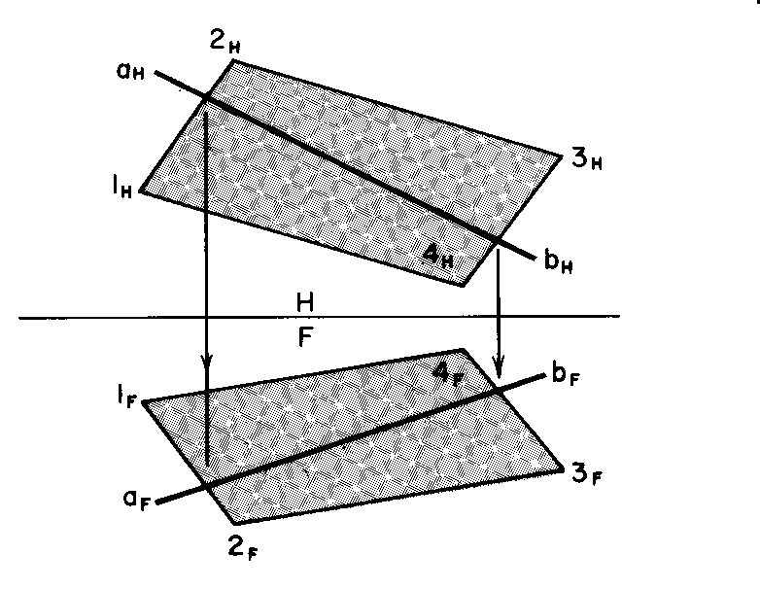
Line In a Plane
A line lies in a plane if the “intersection/touch” points of the line with the plane are in alignment between any two views.
In other words, if there are two points which are common to the line and the plane in any two views, then the line lies in the plane.

Slide 25
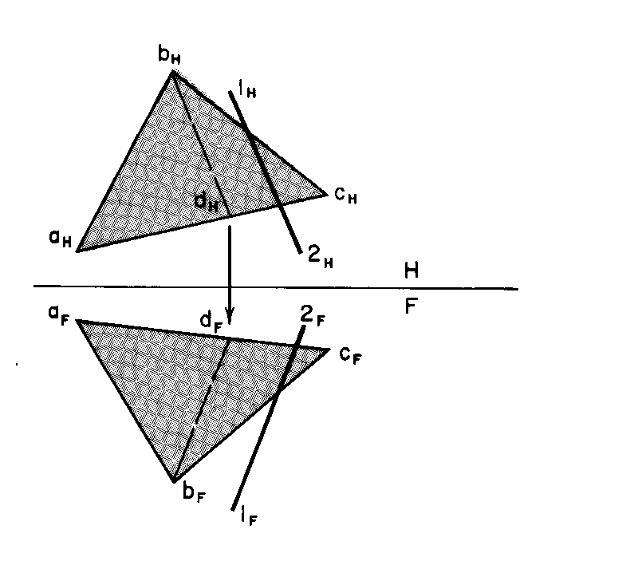

Line Being Parallel to a Plane
Data Provided
Plane abc in two views.
Line 1-2 in H view (only direction defined).
Known that Line 1-2 is parallel to plane abc.
Question
Draw line 1-2 in F view.
Approach
A line on the plane which is parallel to Line 1-2 will be appear parallel in all views of the plane.
Thus, draw a line b-d on plane such that it is parallel to line 1-2 in plane H.
Next, draw projection of line b-d on F-plane.

Slide 26
Finally, draw line 1-2 in Plane-F such that it remains parallel to Line 1-2 in Plane-F as well.
  While doing this ensure that the line Line 1-2 shares some common points with projections of plane abc in F and H planes.

Slide 27

















Problem Statement
Given that a line PQ is parallel to a plane. The true length of PQ is 50 mm. However, we only know Point P’s projection in H plane. Find the other point (Q) of line.
$$P_{H}$$
$$C_{H}$$
$$Q_{H}$$
$$D_{H}$$
$$A_{H}$$
$$B_{H}$$
H
$$Q_{A1}$$
TL
$$B_{A1}$$
50mm
F
$A_{A1}$, $D_{A1}$
$$P_{A1}$$
$$B_{V}$$
EV
$$C_{A1}$$
We start by assuming that PQ is parallel to some line on plane (e.g. AC). Hence, this parallelism will remain in any view including in the EV of Plane ABC.
$$D_{F}$$
$$Q_{F}$$
TL
$$AF$$
F
A1
$$P_{F}$$
$$C_{F}$$
Notes:
0mm in True Length

Slide 28
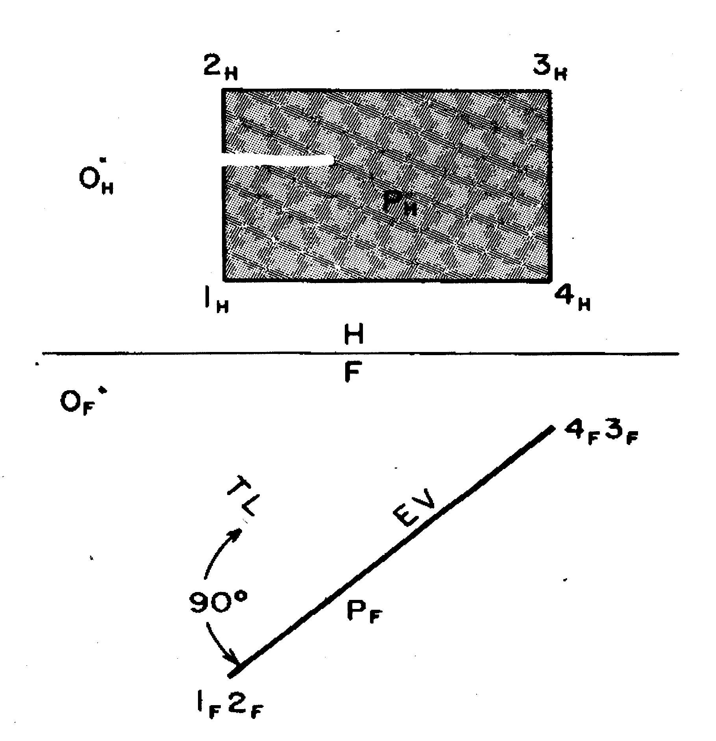

Problem Statement: Finding the SD between a point and a plane
Method:
Develop an edge view of the plane.
Then, the line perpendicular to EV of plane and passing through given point will be of True Length.

Slide 29
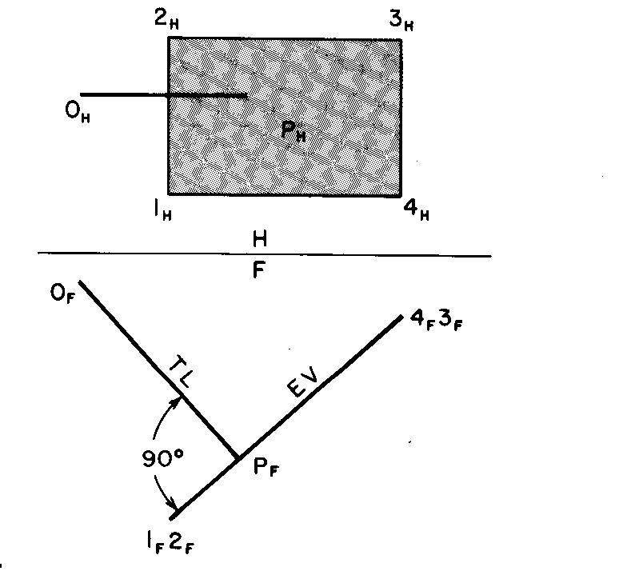

Slide 30
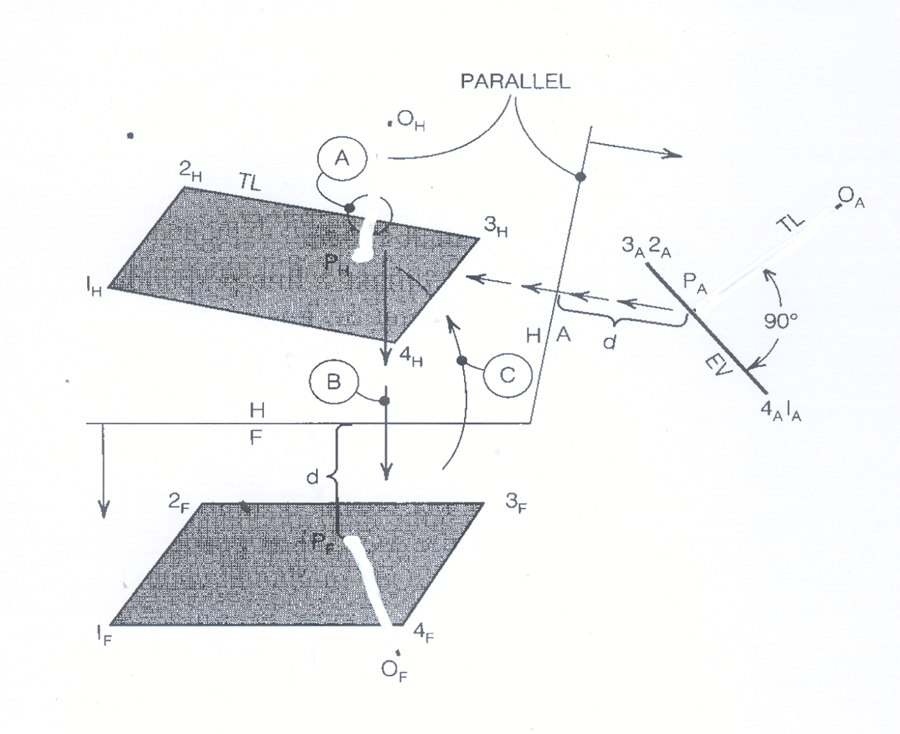

SD when Plane is not in Edge View
Construct an Edge View (EV) of the plane and then add a line perpendicular to the plane.

Slide 31
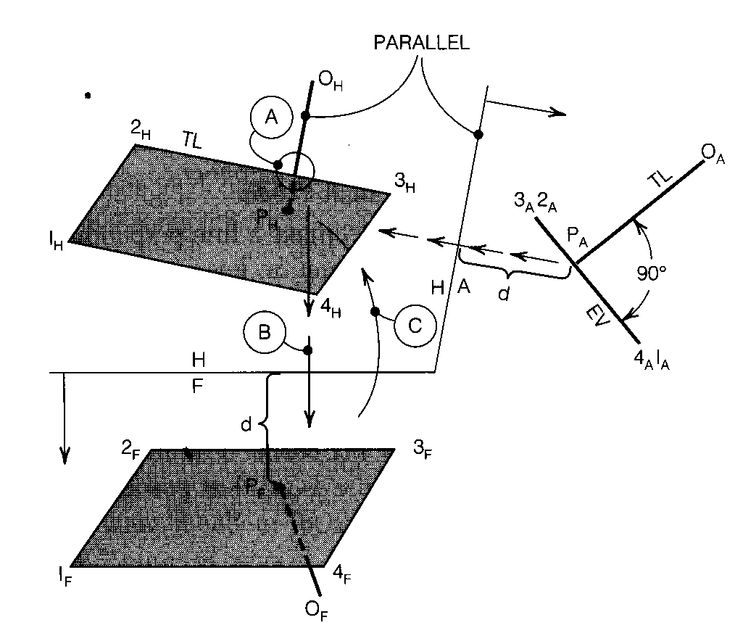

Slide 32
Construct an auxiliary plane H/A perpendicular to sides 1-4 and 2-3.
Transfer distances from the F plane auto plane A to get edge view.
From point ‘0’ drop perpendicular onto EV of plane.
Locate points P on EV and project to plane in H view.
Draw line OP_{H} parallel to folding line H/A, because OP_{A} is in TL.
Locate point P_{F} in F plane using distance ‘d’.

Slide 33

















Problem Statement: Drawing a Line which is perpendicular to a plane from a given Point P.
$$P_{H}$$
$$C_{H}$$
$$Q_{H}$$
$$A_{H}$$
$$D_{H}$$
$$P_{A1}$$
$$B_{H}$$
H
F
$$B_{A1}$$
$A_{A1}$, $D_{A1}$
TL
$$B_{F}$$
EV
$$P_{F}$$
$$Q_{A1}$$
$$D_{F}$$
$$C_{A1}$$
TL
$$A_{F}$$
$$Q_{F}$$
F
A1
$$C_{F}$$

Slide 34
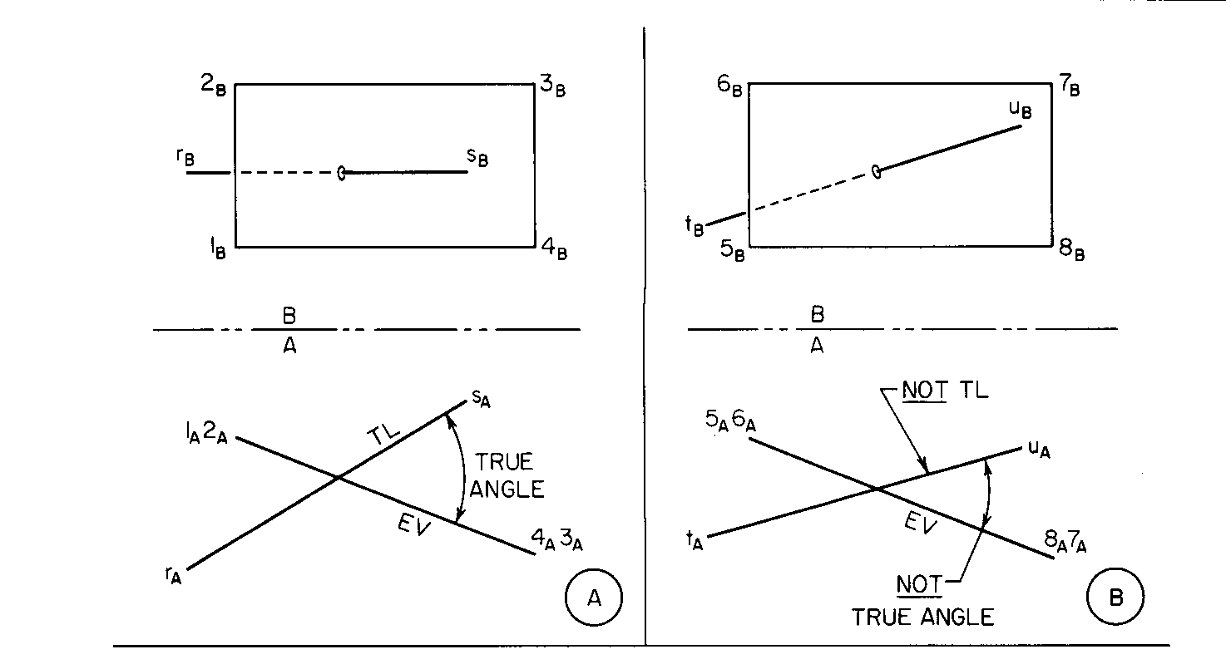
Angles Between Line & Planes
True angle is when the plane is in its edge view and the line is in its true length.

Slide 35
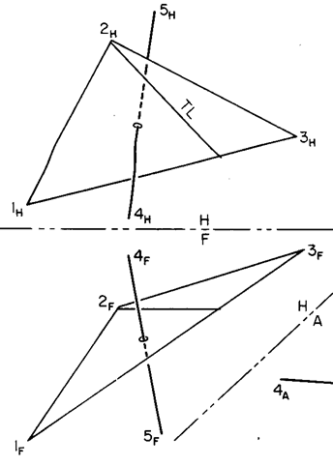
Angle Between Oblique plane & Line
A TL line was added to plane in H view.
An EV was constructed in A view.
Line 4-5 was carried over to A view.
True shape of plane is constructed by taking view perpendicular to line 4-5 in view C.
TL of line is constructed in view C along with EV of plane.

Slide 36
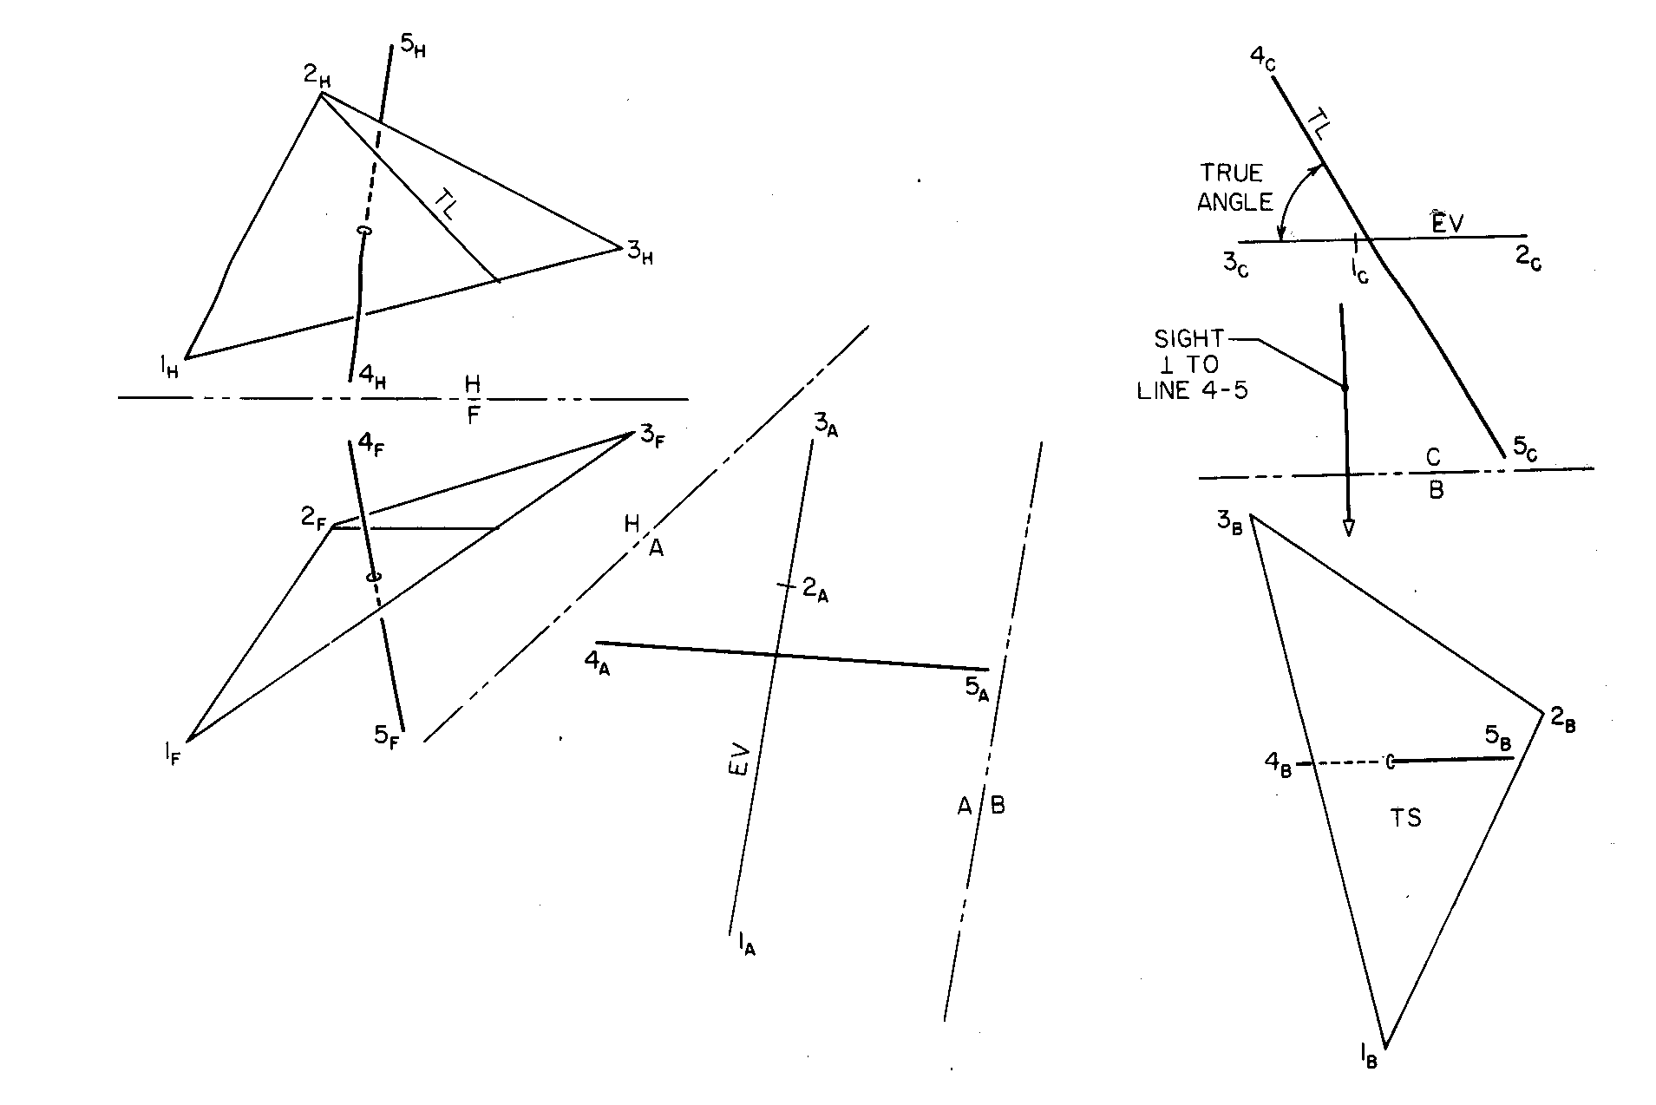

Slide 37
Angle Between a Line and a Plane
Goal: The line should be in TL and plane in EV.
First get the plane in EV & project the line in A1.
Now get the plane in true shape and project line in A2
Take an auxiliary plane such that line is in TL and plane in EV.
B_{H}
E_{H}
D_{A3}
TRUE
ANGLE
TL
TL
C_{A3}
A_{A3}
C_{H}
H
B_{A3}
A_{H}
A1
HP
D_{H}
A1
D_{F}
C_{A1}
A2
E_{A3}
A3
FP
B_{F}
C_{F}
C_{A2}
A2
B_{A1}
E_{A1}
D_{A1}
B_{A2}
A_{F}
E_{F}
EV
D_{A2}
TS
E_{A2}
A_{A1}
A_{A2}

Slide 38
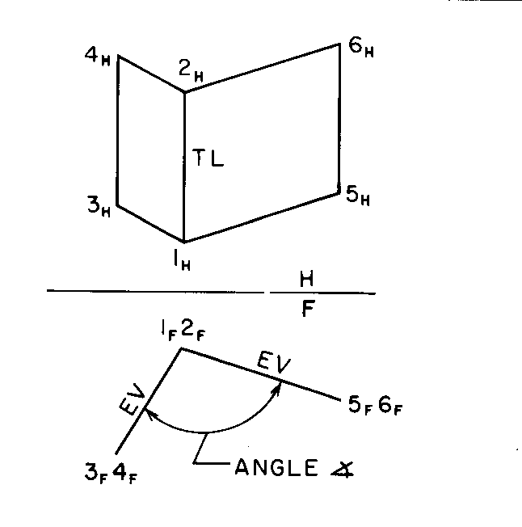
Angle Between Two Planes
True angle between edge views of planes.

Slide 39
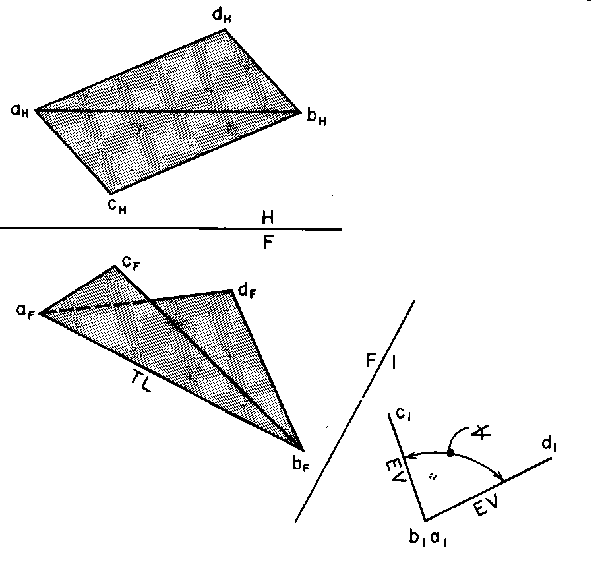

Slide 40
Angle Between Two Planes
The angle would be available in the auxiliary plane showing the two planes in EV.
Step 1: Draw a common line in TL.
Step 2: Draw the PV of the common line.
  The same auxiliary view would give the angle between two planes.

Slide 41
Angle Between Two Planes
Find the TL of a common line (AB) between the two planes
D_{H}
H
D_{A2}
A_{H}
A1
EV_{ABD}
C_{H}
Ø
D_{A1}
EV_{ABC}
B_{H}
A_{A2,}B_{A2}
C_{A2}
Then, find PV of common line, two planes will be in EV.
H
TL
A_{A1}
F
D_{F}
B_{A1}
C_{A1}
A1
A2
B_{F}
C_{F}
A_{F}
True angle between the two planes would be available in A2.

Slide 42

Visibility of a Line
4H
Note that Line 4-5 is seen first and Line 2-3 is seen second in HV.
Method
3A
Select an point of apparent intersection between two lines (say 4-5 and 1-2) in a particular view.
Project it onto an adjacent view (in this case, F plane).
Identify which of the two lines is encountered first as you move down along the projector in the adjacent view.
The line encountered first will be visible and the other line will be hidden in the original view.
M_{H}
2H
Therefore, Line 4-5 must be below plane 1-2-3 in HV at A (4-5 is hidden from A to M_{H})
A
1H
5H
HF
1F
2F
4F
M_{F}
Note that Line 1-2 is seen first and line 4-5 is seen second in FV
B
5F
3F
Therefore, Line 4-5 must be in-front of plane 1-2-3 in FV at B
(4-5 is visible from B to M_{F})

Slide 43
Thank You

